Slide 1
COVID Patient Tracker System Group 5
Contributions of different members
Jannatul Farzana Tandra (19101097):- Project Scenario, Requirement analysis, Use case Diagram
Mahmudul Hasan Emon (19101098):- Activity Diagram, Sequence Diagram-1
Sadia Sobhana Ridi (18301279):- Sequence Diagram-2, Data flow Diagram
‹#›

Slide 2
Project Scenario
The story to make this project: To make a connection between the COVID affected patients and doctors so that patient can easily get any service as per their requirements also to keep the track of COVID affected and recovery patients so that Government and Health ministry can take effective measures so that they can reduce this epidemic as much as possible.
How the system will work?
: Using this system patients can register/login into the website, can see the updated lists of appointments of doctors, available ICU beds, available vaccine. Also can take emergency service from the hotline service 24 hours etc.
: Using the system patient can test his/her COVID test also can book a slot for taking their vaccine.
: System will keep track of daily affected, dead and recovery patient lists and send it to the respective authority to take an action by observing those ratio.
‹#›

Slide 3
Requirement analysis
Functional requirements:
1. User can login with their username and password into this system.
2.User will be able to book an appointment of doctors, vaccines, COVID test etc..
3.Authority will be able to update their database of affected, dead and recovery patient list on a daily basis.
4. Authority will be able to update their available doctors list, number of ICU beds, amount of vaccines, emergency contact etc.
5. Government authority will be able to enforce lockdown by analyzing the daily ratio of COVID affected people also they can encourage the common people to wear mask etc.
Non-functional Requirements:
1. System should be able to work on any web browser.
2. System will be kept updated within every 5 milliseconds.
3. System must be protected from all unauthorized attempts to read or modify it’s data.
4. System should provide the capability to backup their data.
5. The cost of maintaining the system should be low.
‹#›

Slide 4
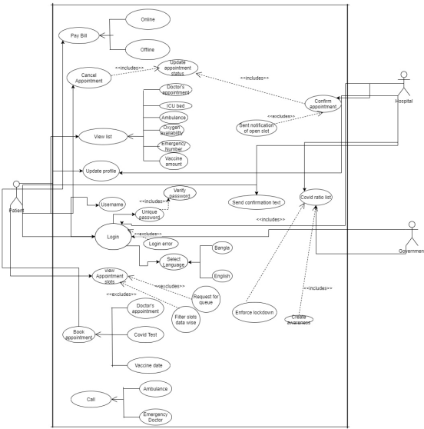
USE Case Diagram
Please visit for clear version of this diagram:-
https://drive.google.com/file/d/1wAW7IGfLCWMCKAzuD-X9eku2myIc3Krq/view?usp=sharing
‹#›

Slide 5
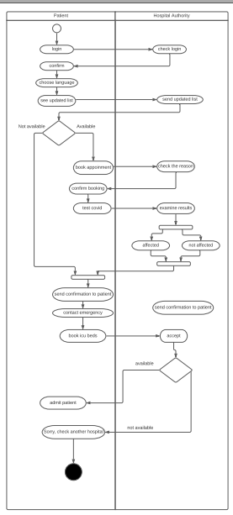
Activity Diagram for Patient and Hospital authority
Please visit for clear version of this diagram:-
https://drive.google.com/file/d/1vgVRgxWxZkqRmm7f7kBRbdUS6AMAMMmT/view?usp=sharing
‹#›

Slide 6
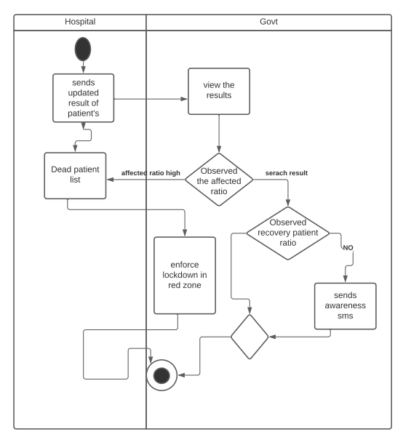
Activity Diagram for Hospital authority and Government authority
‹#›

Slide 7
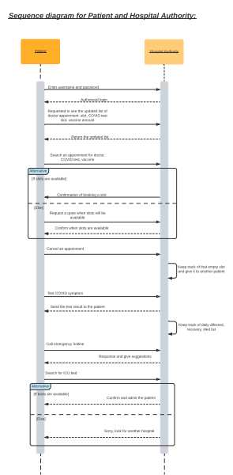
Sequence Diagram for Patient and Hospital authority
Please visit for clear version of this diagram:-
https://drive.google.com/file/d/1NEL2U5Rc6oytNtKs_cVejwaMr9DPJ3cA/view?usp=sharing
‹#›

Slide 8
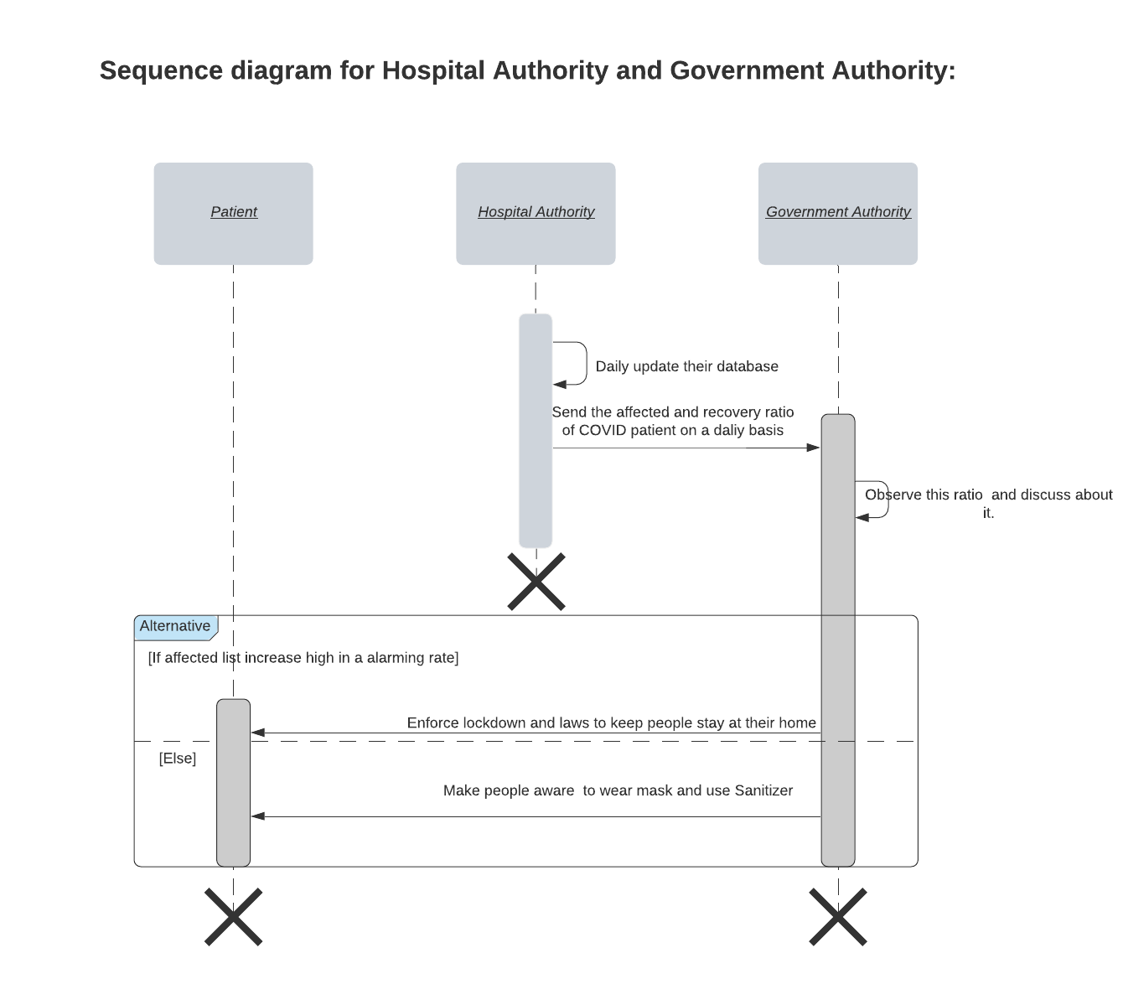
Sequence Diagram for Hospital authority and Government authority
‹#›

Slide 9
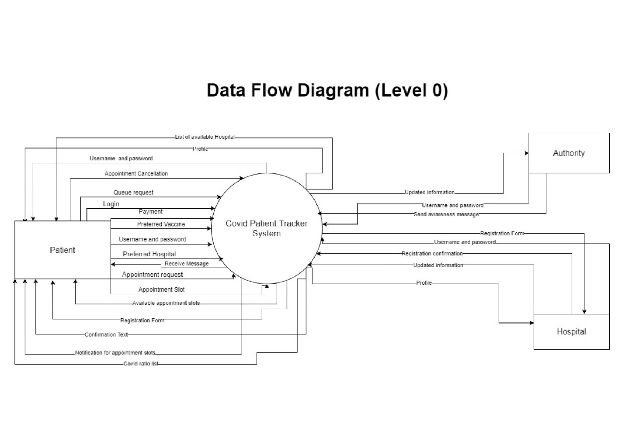
Data Flow Diagram (Level 0 diagram)
‹#›

Slide 10
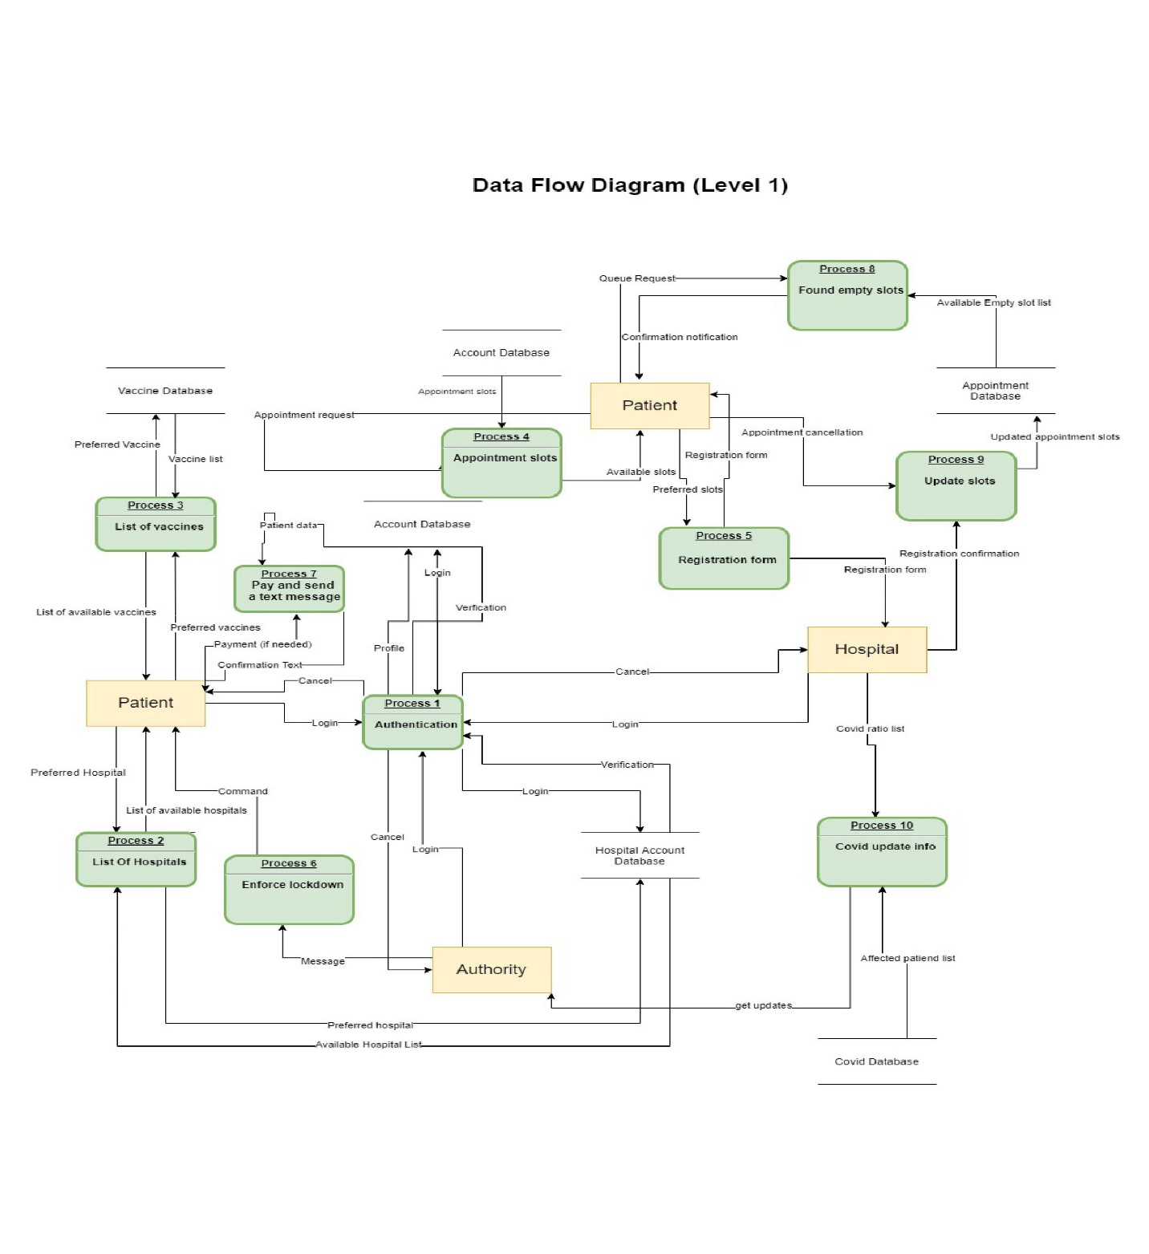
Data Flow Diagram (Level-1 diagram)
Please visit for clear version of this diagram:-
https://drive.google.com/file/d/1NbbgdpEqBNQZc6anFztUnXysGHqxf9qK/view?usp=sharing
‹#›

Slide 11
Thank You

